Slide 1
Mastering the user experience with bots

Slide 2
Asking the user for simple information
Notes:
Show text prompts

Slide 3
Some basic facts about humans
Humans need guidance
Humans are complex
Humans can be random
Humans don’t fit a pattern

Slide 4
Hello?
Hi there! I’m M.A.X.!
???

Slide 5
I'd like to report an issue with Rover 7. The soil collection modules seem to be failing. We are unable to complete our project because of this issue.
I'll get that logged!

Slide 6
tl;dr
Buttons are a good thing
Notes:
Starting the bot with an open-ended question such as "How can I help you?" is generally not recommended. If your bot has a hundred different things it can do, chances are users won’t be able to guess most of them. Your bot didn’t tell them what it can do, so how can they possibly know?+
Menus provide a simple solution to that problem. First, by listing the available options, your bot is conveying its capabilities to the user. Second, menus spare the user from having to type too much. They can simply click. Finally, the use of menus can significantly simplify your natural language models by narrowing the scope of input that the bot could receive from the user.

Slide 7
Bots do not need any of the following
Machine Learning
Artificial Intelligence
Natural Language Processing
Speech Recognition

Slide 8
Pattern: Menu breakdown
So instead:
Hello user! How can I help you?
What types of events are you interested in?
What music would you like?
(By the way, next time you could just type “I’m looking for music events” and I will know what to do.)
Events
Music
Stages
Comedy
Amenities
Film
Laser Dome
Spectacles
Theater

Slide 9
Using menus
Guide the user
Channels often offer specialized menus, quick actions, etc.
Help the user discover what your bot can do
Read more

Slide 10
Guiding the user
Notes:
Show:
Choice
Confirm
Buttons in cards

Slide 11
Dialogs
Reusable modules
Perform a single operation
Callable from other dialogs
Can be made "global"

Slide 12
Register
CancelRoom
SubmitSession
CancelRegistration
PartyRegistration
FindSession
CheckRegistration
EventInformation
ChangeSession
LodgingInformation
SessionInformation
CancelSession
BookRoom
SpeakerInformation
PostPhoto

Slide 13
Dialog stack
GetSubsystem
Data
GetEquipmentType
Data
ReportIssue

Slide 14
I'd like to make an appointment
to service Rover 3
Absolutely! I have 11:30 and 12:30 available. What timeslot would you want?
What building is the service station in?

Slide 15
Creating global handlers
Node.js
triggerAction
Set matches to either a regex or the name of an intent
(You'll actually use this to start most dialogs)
C#
Implement ScorableBase
PrepareAsync method looks for text or intent

Slide 16
Providing help
Notes:
Show:
Scorables
triggerAction

Slide 17
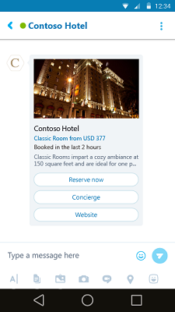
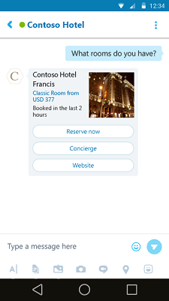
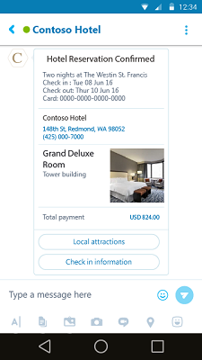
Bots are more than just text interfaces
Hero
Thumbnail
Receipt

Slide 18
Built-in card types
Framework provides several card times
Node.js
.NET
Send rich media
Images
Video
Audio
Not supported by all channels
Channels may have different implementations
Can almost be considered a "suggestion" to the channel

Slide 19
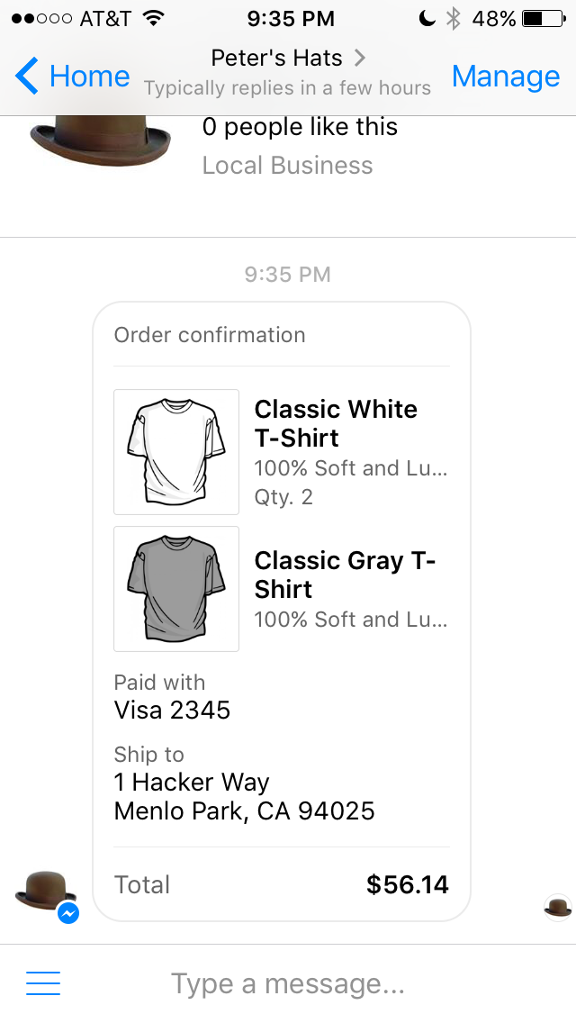
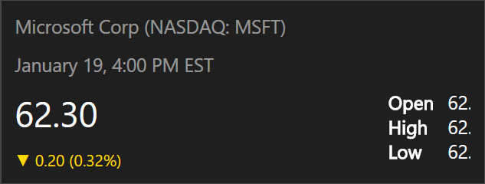
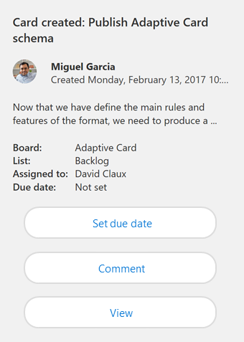
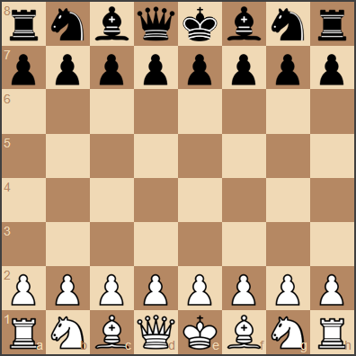
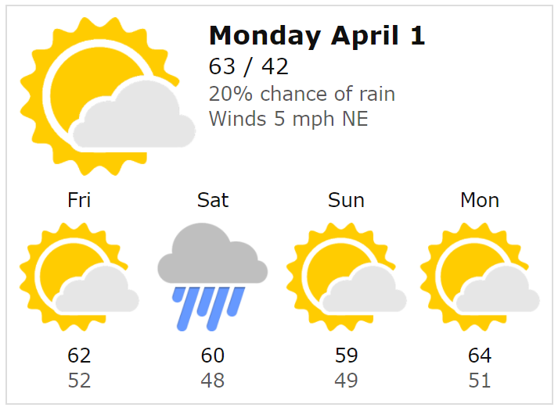
Filling the middle ground
Fixed templates
Complete control
No flexibility
Update Treadmill
Adaptive Cards
Flexible enough payload to cover 80% of needs
Host maintains strong control over style and security
Html Canvas
No consistency
No control
Security issues

Slide 20

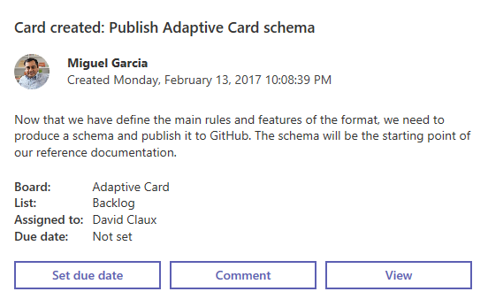
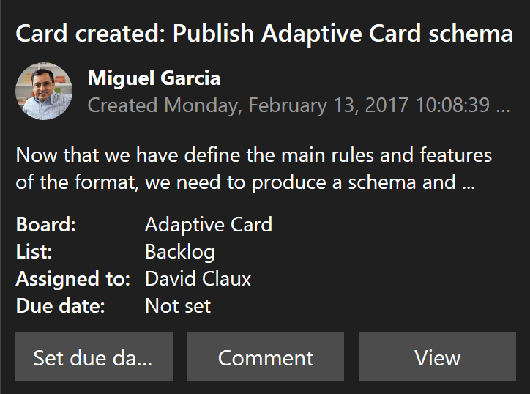
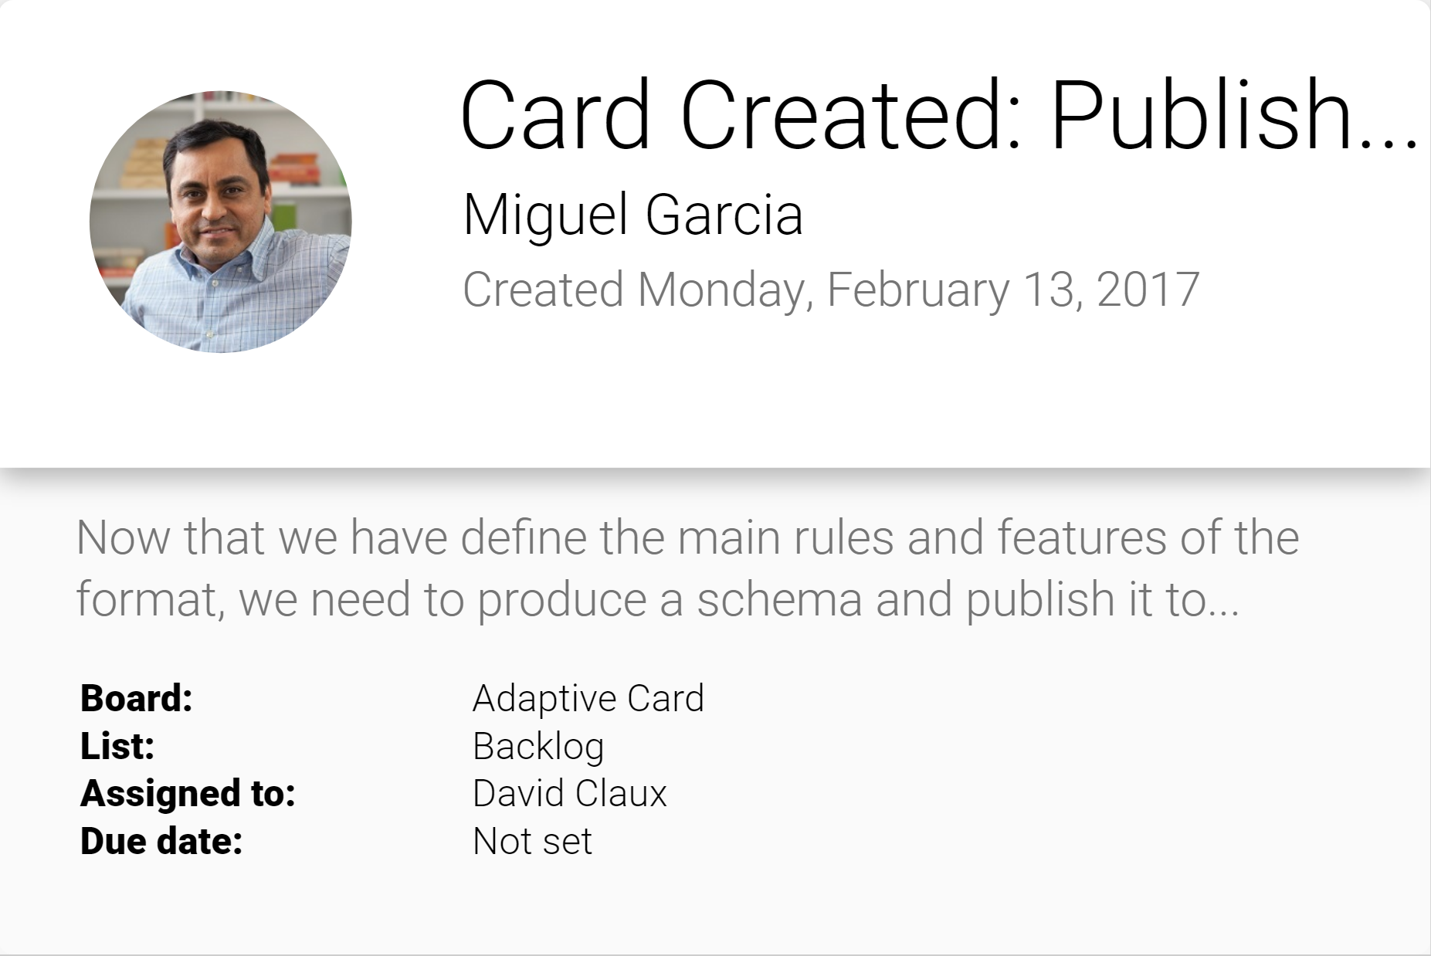
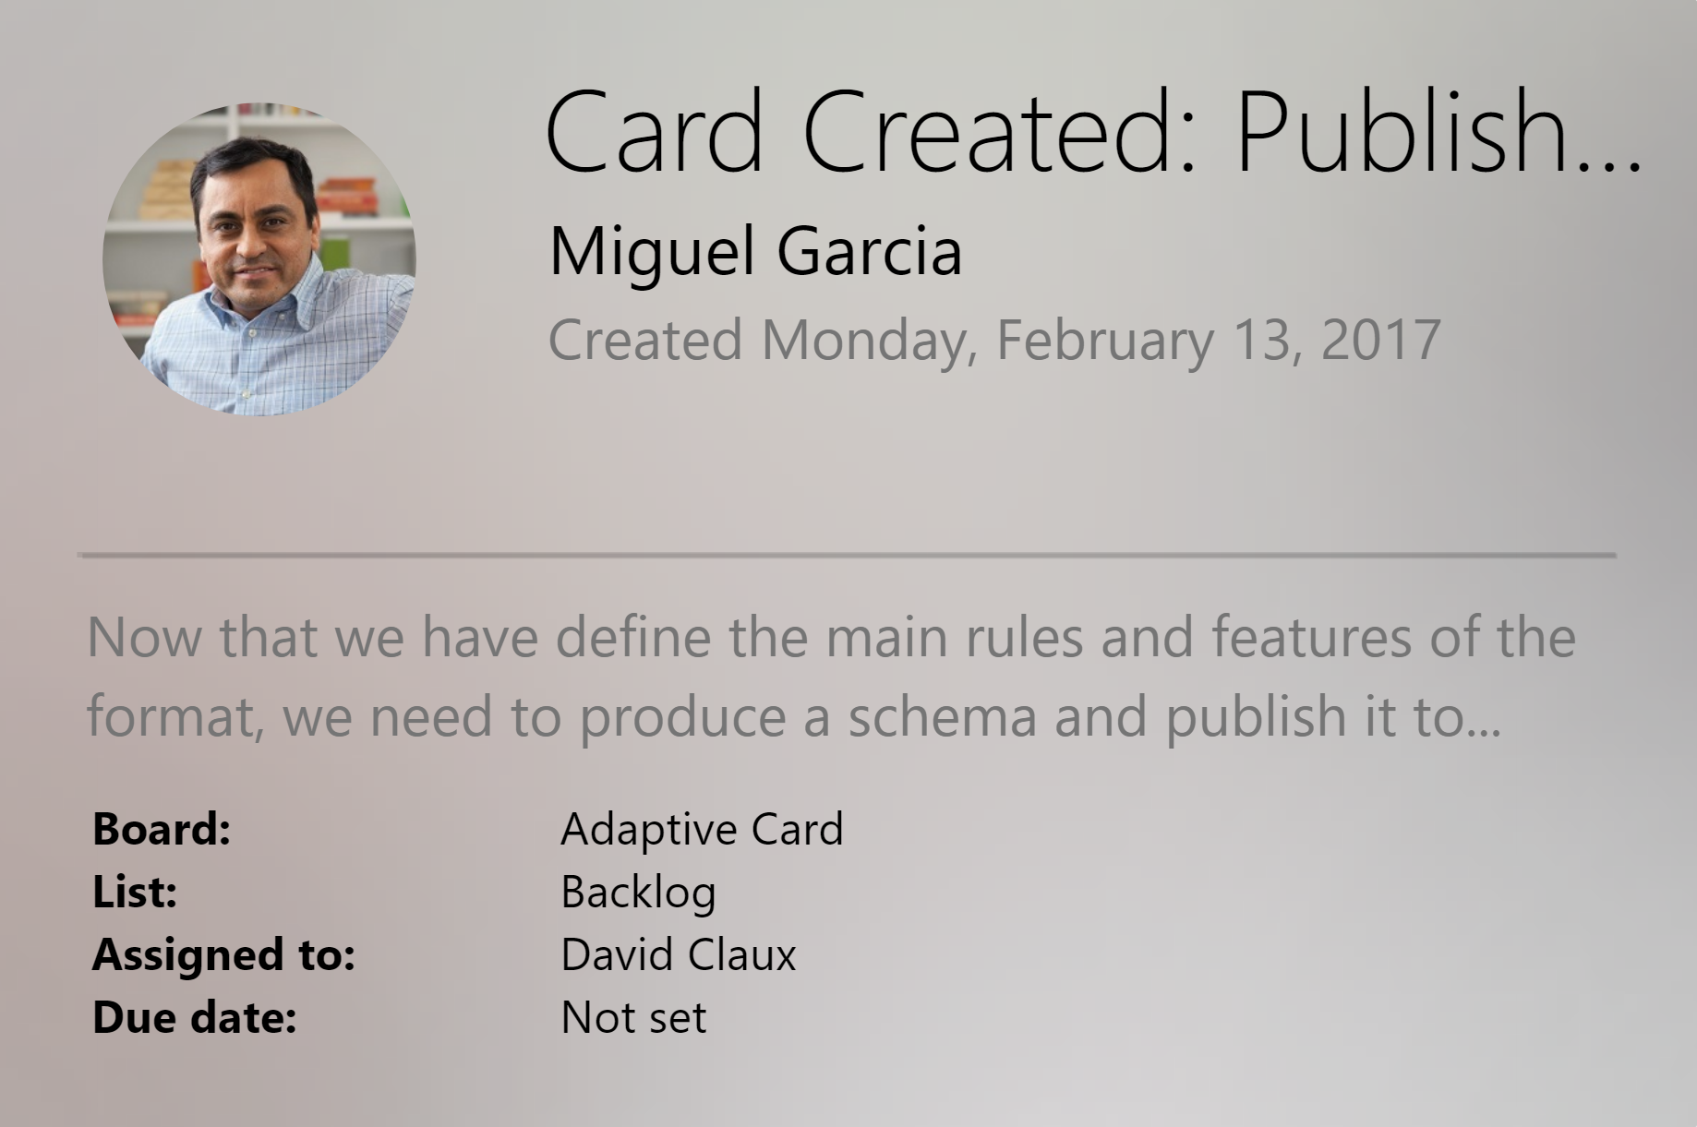
Adaptive Cards
Open FRAMEWORK
Multiple canvases
Notifications
Microsoft Teams
Skype
Android
iOS

Slide 21
Creating your own cards
Notes:
Show:
adaptivecards.io
Code to create adaptive cards

Slide 22
Your turn…
Update your bot to:
Allow users to enter trouble tickets
Category
Severity
Description
Confirm that all information is correct
Send the ticket displayed as a card

